Slide 1
HANDY ATTENDANCE
MINOR PROJECT

Slide 2
INTRODUCTION

Slide 3
FUNCTIONALITY
Mark class attendance on personal mobile and stores.
Provides percentage report.

Slide 4
FEATURES
Stores data in the SQLite database.
Allows creation of batches/classes with user defined names.
Addition of students to respective batches is done manually.
Marking of attendance
Monthly wise.
Is done by checking the checkboxes against each student.

Slide 5
PROVIDES MONTHLY VIEW
Displays total classes attended per month.
Total classes attended of whole session.
#classes conducted per month.

Slide 6
PROVIDES FINAL REPORT
Provides a final percentage report of whole session.
Total classes conducted.
Total classes attended by each student.
Percentage of attendance.

Slide 7
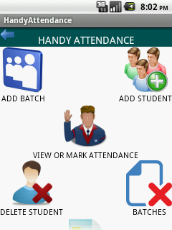
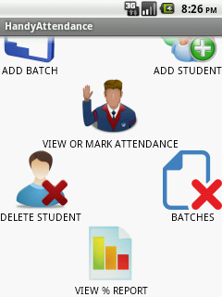
MAINPAGE

Slide 8
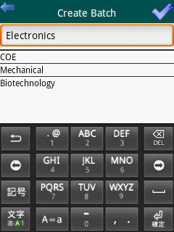
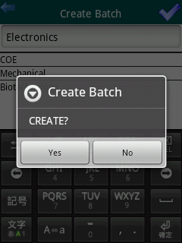
CREATING BATCH

Slide 9
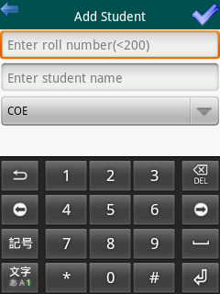
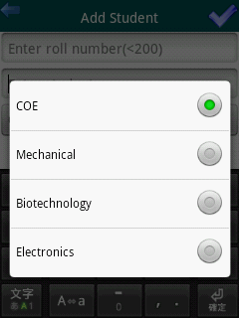
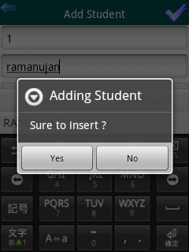
ADDING STUDENT

Slide 10
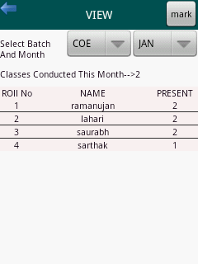
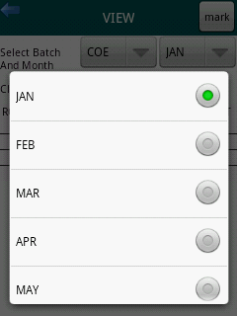
MONTHLY VIEW

Slide 11
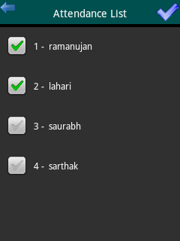
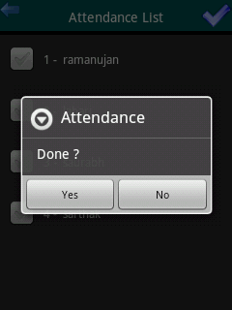
MARKING ATTENDANCE

Slide 12
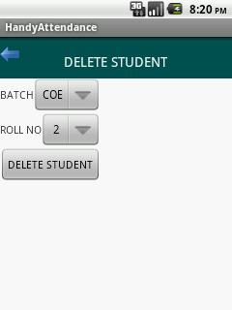
DELETING STUDENT

Slide 13
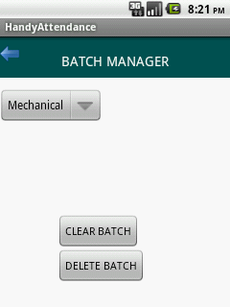
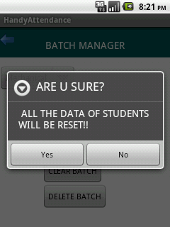
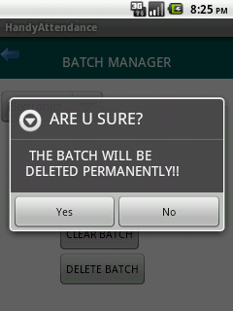
CLEAR / DELETE BATCH

Slide 14
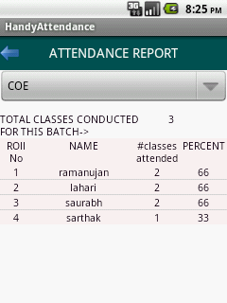
PERCENTAGE REPORT OF SESSION

Slide 15
Key Features
A list of students may be used again in next session without need of reentering names by clearing the previous data.
No two students of same batch will have same roll number/ID.
Roll no is an integral value .
A batch can have max of 200 students(i.e., roll no<=200 ).

Slide 16
Technology used
Android SDK
Android SQLite database
Eclipse

Slide 17
DOCUMENTATION

